Slide 1

Identifying Good Measurement
Morling, Ch. 5

Slide 2
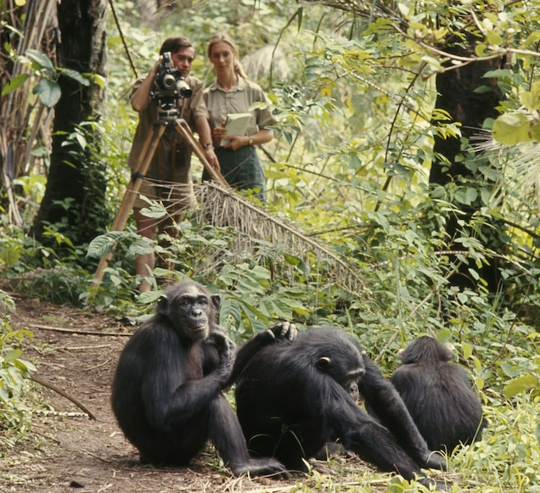
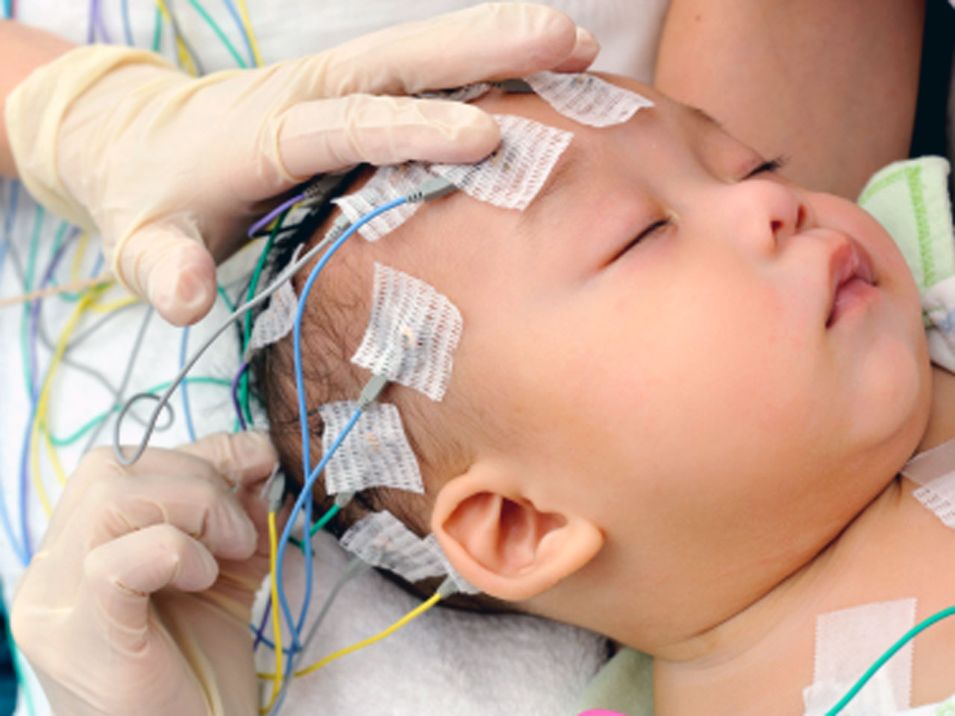
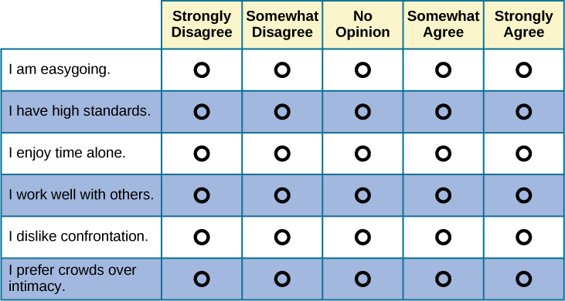
Types of Measures
Self-Report
Observational
Physiological
People answer answers about themselves in a questionnaire or interview.
Venus has a beautiful name, but it’s hot
Despite being red, Mars is actually cold

Slide 3

Identifying Good Measurement: Reliability
01
02
03
Test-Retest
Interrater
The consistency in results every time a measure is used.
The degree to which two or more coders or observers give consistent ratings of a target behavior
Internal Consistency
The consistency in a pattern of answers, no matter how the question is phrased

Slide 4

Application: Beck Depression Inventory
Test-Retest
Interrater
r = 0.73 to 0.96
N/A
Internal Consistency
r $≈$ 0.9

Slide 5
Identifying Good Measurement: Validity
Face
Content
Criterion
Does the measure look like it measures a given construct?
Does the measure capture all parts of a given construct?
Is the measure associated with the relevant behavioral outcome?
Convergent
Discriminant
Does the measure correlate with measures of similar constructs?
Does the measure not correlate with measures of dissimilar constructs?

Slide 6
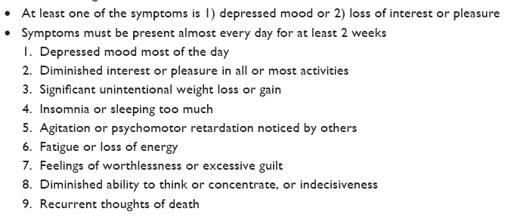
DSM-5 criteria for a major depressive episode

Slide 7
Application: Beck Depression Inventory
Face
Content
Criterion
Does the BDI look like it measures depression?
Factor analysis revealed two constructs: cognitive-affective and somatic-vegetative
Is the measure associated with the relevant behavioral outcome?
Convergent
Discriminant
BDI with CES-D, HAM-D, SDS, MADRS, and GDS:
r = 0.66 to 0.86
BDI is weakly correlated with measures of dissimilar constructs
(r < 0.4)

Slide 8
Operationalizing Aggression
Define rules for coding: write them in the empty “rules” box.
What counts as aggression?
Be specific

Slide 9
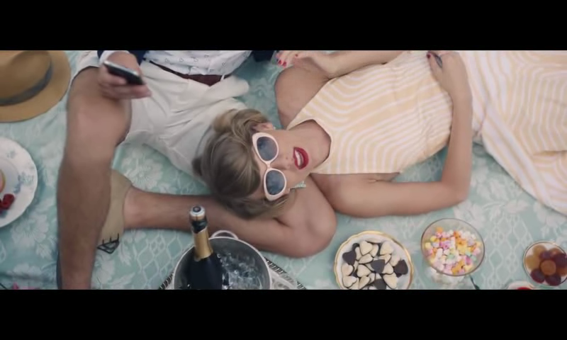
Operationalizing Aggression
Code for “aggression.”
For each 10 second clip, rate how much aggression is displayed on a scale of 1–10.

Slide 10
Operationalizing Aggression
Change scale to ratio
Using tallies: how many times was aggression (as you have operationalized it) present in each clip?

Slide 11
Operationalizing Aggression
RATIO
Using tallies: how many times was aggression (as you have operationalized it) present in each clip?

